Slide 1

Software Requirements Specification (SRS) FSKSM Timetable Management System
Lecturer: MOHD RAZAK BIN SAMINGAN
Member: RUHUL QUDDUS TAMIM A19MJ0182
MD YUSUF BIN FORKAN A19MJ0178
SHAFI AHMED A19MJ0184
SYAFIQ IBNU RAMADHAN A19MJ0185

Slide 2
Table of Contents
Introduction 3
Overall Description 6
External Interface Requirements 16
System Features 23
Non-Functional Requirements 34
Appendix 37

Slide 3

Introduction

Slide 4
Purpose
The criteria for FSKSM E-Learning are described in this SRS (Mobile). Use case diagrams, tables, and the intended GUI are used to explain the provided requirements. The target audience, which consists of stakeholders and user groups, may utilise the requirements description to:
Student from School of Computing, University Technology Malaysia (UTM).
Lecturer from School of Computing, UTM.
Dr Mohd. Razak bin Samingan, as the representative of FSKSM, UTM.

Slide 5
Scope
The modules of this system are student module, lecturer module.
Scope of the student module 1. Generate timetable based on current session with lecturer name. 2. Generate current session timetable based on room number and level.
3. Generate student timetable based on their course code and intake.
Scope of lecturer module 1. Generate lecturer timetable based on their name.
2. Generate current session timetable based on room number and level.

Slide 6

Overall Description

Slide 7
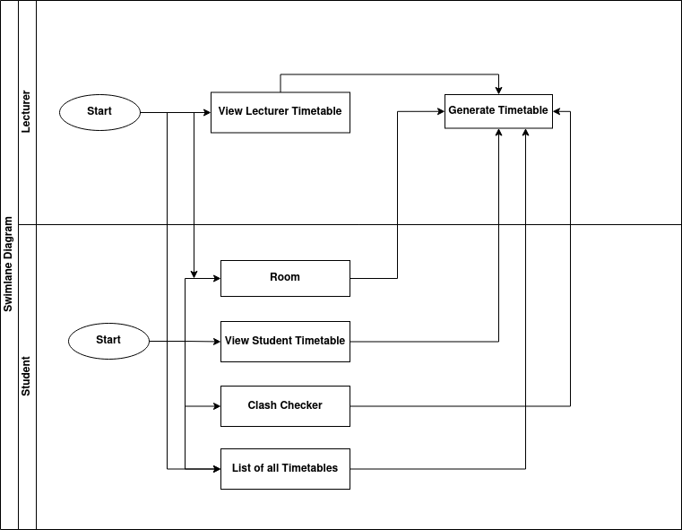
Business Process Diagram
End users of the system are consisting of “Student” and “Lecturer”. These different types of user may use mobile device, desktop computer or both as a frontend to access the system.
Student – can click on their timetables for class, clash checker, room no and the list of all timetables for all courses.
Lecturer – can view his/her schedule and locate his/her room number.

Slide 8
Hardware Interface
Android Mobile Device - The mobile platform with internet connection where FSKSM mobile application is to be installed used by student and lecturer to access services provided.
Server Machine - Physical/Virtual machine where Windows Server will be installed.
Client Machine - Desktop computer with browser software and internet connection used by student and lecturer to access FSKSM as Web-based application in desktop environment.

Slide 9
Software Interface
Java Development Kit (JDK) - Provides Java language environment for mobile application development and Java compiler to integrate and build Java-based modules of Android system.
Android SDK - Java-based libraries that provide APIs to control Android mobile device.
MySQL Database Server - Open-source relational database management system to organize application data
Apache Web Server - Open-source Web server software to host MOBAC content and server-side logic

Slide 10
Communication Interface
The system relies on HTTPS, FTP, CGI and MySQL protocols for communications among its components.

Slide 11
Operations
We can only retrieve data from the server because all of the data is already stored on the FSKSM server and we don't have permission to update the database.

Slide 12
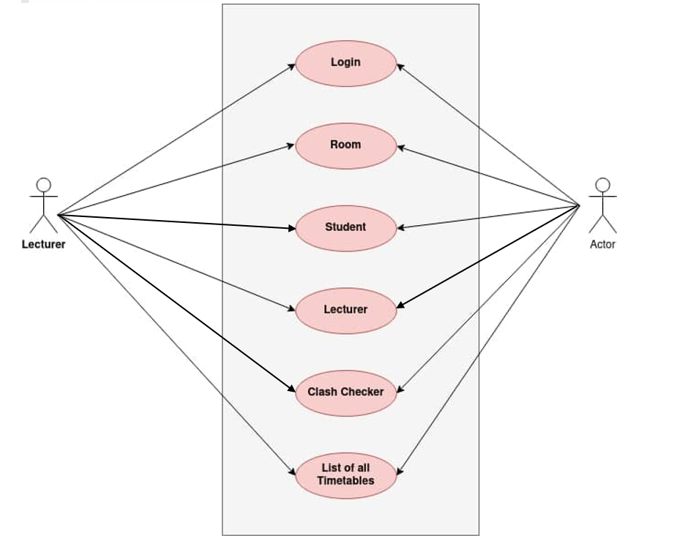
Product Function

Slide 13
User class and Characteristics
Student - This includes all students enrolled in UTM's School of Computing. They should only have limited access to some services, such as viewing other students' information.
Lecturer - This includes all lecturers affiliated with UTM's School of Computing. Certain functions, such as examining the subjects the student took over the semesters, should be restricted.

Slide 14
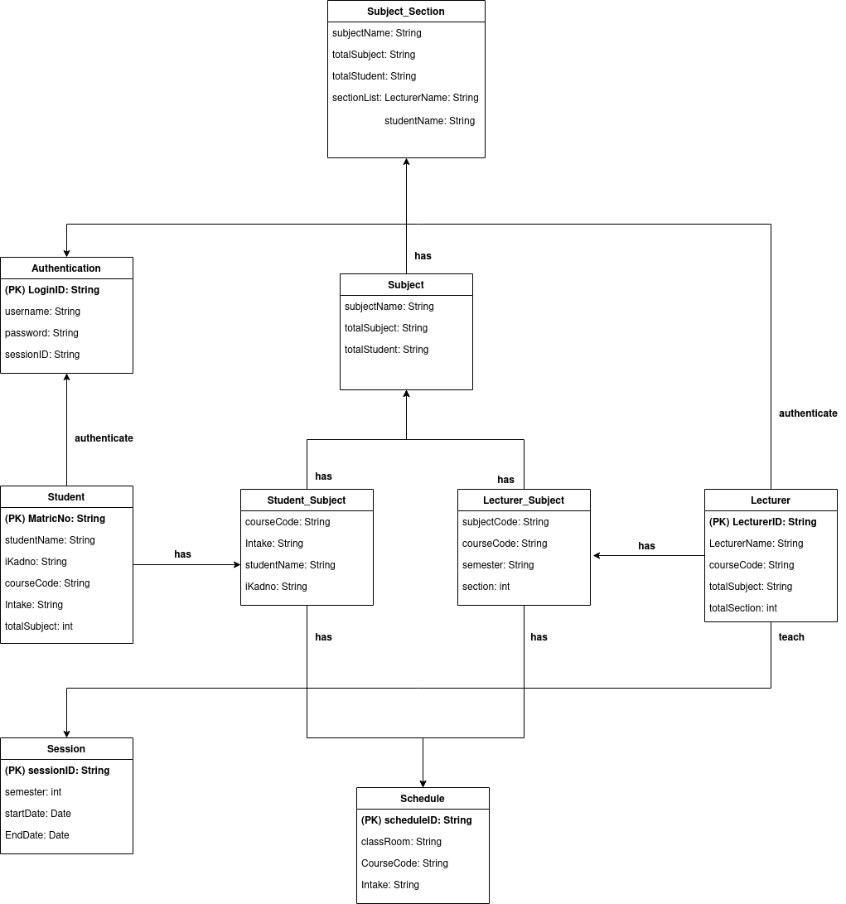
Conceptual ERD

Slide 15
Constraints
The step of entering data needs to be sufficient and effective. Sufficiency means a complete set of constraints which can be reflected in the system. Control and strong security procedures must be used to prevent FSKSM server through JSON from damages.

Slide 16

External Interface Requirement

Slide 17
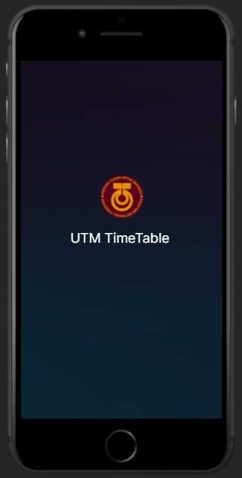
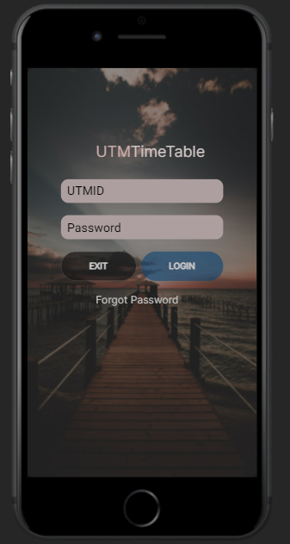
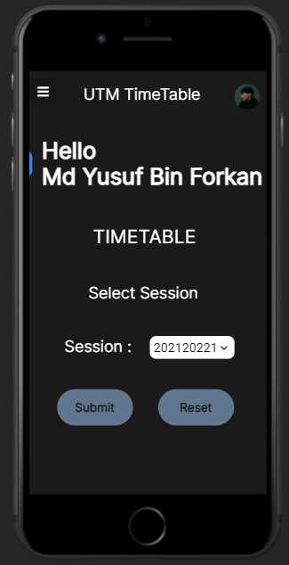
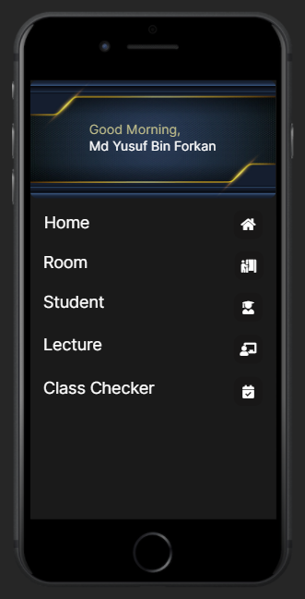
User Interface
Start-up page
Login page
Home page
Menu

Slide 18
User interface (cont.)
The user enter UTMID and password to login to the app.
The user will be directed to the Home page where the user can select session and clicks on Submit to procced to view Menu page.
From the Menu page the user can proceed to other pages

Slide 19
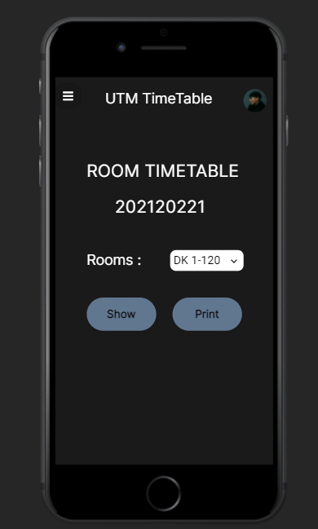
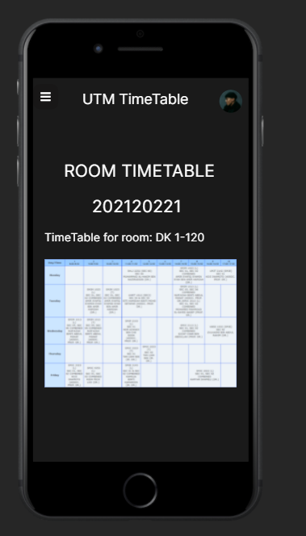
User interface (cont.)
The user selects the Room page from the Menu page.
The user is directed to Room page where the user searches for the room from the drop-down list and clicks on Show button.
The user is directed to a new page where the selected Room Timetable is shown.

Slide 20
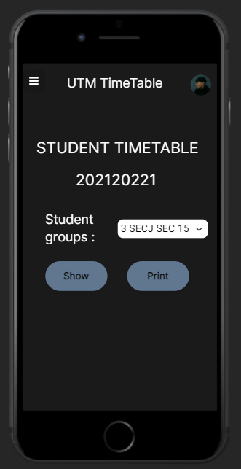
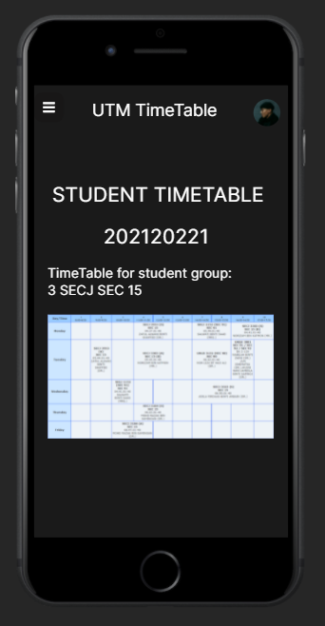
User interface (cont.)
The user selects the Student page from the Menu page.
The user is directed to Student page where the user searches for the student group from the drop-down list and clicks on Show button.
The user is directed to a new page where the selected Student Timetable is shown.

Slide 21
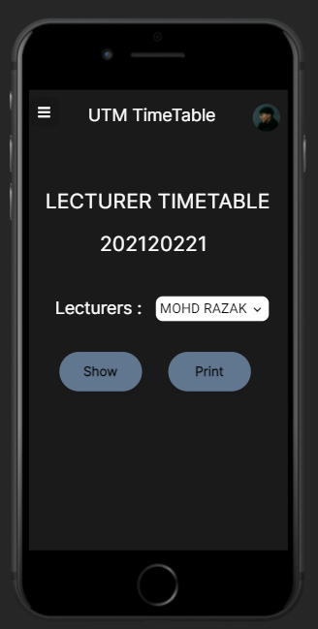
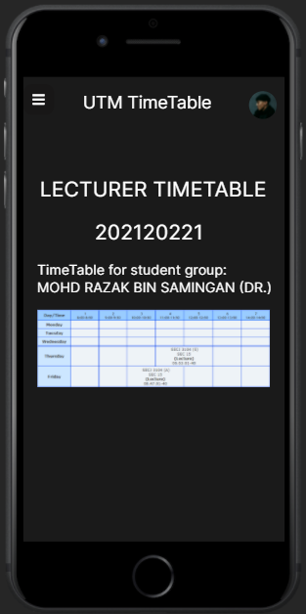
User interface (cont.)
The user selects the Lecture page from the Menu page.
The user is directed to Lecture page where the user searches for lecturers from the drop-down list and clicks on Show button.
The user is directed to a new page where the selected Lecturer Timetable is shown.

Slide 22
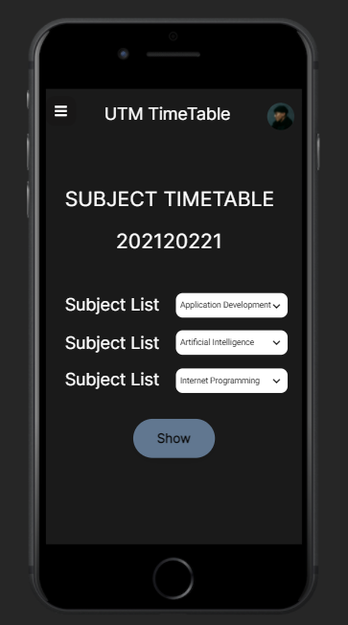
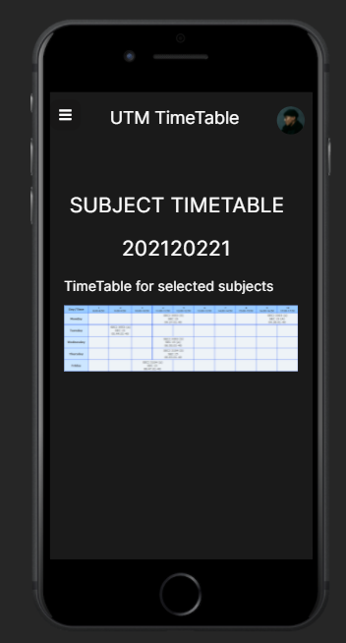
User interface (cont.)
The user selects the Clash Checker page from the Menu page.
The user is directed to Clash Checker page where the user selects several subjects and clicks on Show button.
The user is directed to a new page where the Subject Timetable of selected subject is shown. It also shows an error message if 2 subjects clashes.

Slide 23

System Features

Slide 24
UC001 – Login
Use Case: Login
Id: UC001
Description: User login into the system
Goal: To allow actor login into the system
Actor: Student, Lecturer
Precondition: None
Normal Flow: Actor provide username and password System send login information to database Database returns login status System allow or deny access if wrong input

Slide 25
UC001 – Login(cont.)
Use Case: Login
Alternate Flow: None
Exception Flow: None
Postcondition: None

Slide 26
UC002 – Room
Use Case: Room
Id: UC002
Description: The user clicks on the room to see class being held in the room
Goal: To allow actor to view the room
Actor: Student, Lecturer
Precondition: Actor need to be logged in
Normal Flow: Actor clicks on “Room” tab The system shows the classes held in that specific room System allow or deny access if wrong

Slide 27
UC002 – Room (cont.)
Use Case: Room
Alternative Flow: None
Exception Flow: None
Postcondition: Actor able to see the modules based on their roles

Slide 28
UC003 – Student
Use Case: Student
Id: UC003
Description: View students’ timetable
Goal: Check students’ availability
Actor: Student
Precondition: Actor needs to be logged in
Normal Flow: Actor clicks on “Student” tab The actor clicks the preferred intake to be viewed The actor click show “Show” to see the timetable of that specific intake The system shows the timetable of that specific intake

Slide 29
UC003 – Student (cont.)
Use Case: Student
Alternative Flow: None
Exception Flow: None
Postcondition: Actor able to see the modules based on their roles

Slide 30
UC004 – Lecturer
Use Case: Lecturer
Id: UC004
Description: View lecture timetable
Goal: To check when lecturer will take class
Actor: Lecturer
Precondition: Actor needs to be logged in
Normal Flow: Actor clicks on “Lecturer” tab Actor selects the preferred lecture to be view Actor clicks on “Show” for viewing timetable System displays lecturer timetable

Slide 31
UC004 – Lecturer (cont.)
Use Case: Lecturer
Alternative Flow: None
Exception Flow: None
Postcondition: Actor able to see the modules based on their roles

Slide 32
UC005 – Clash Checker
Use Case: Clash Checker
Id: UC005
Description: View clash checker timetable
Goal: To check subject that clashes
Actor: Student, Lecturer
Precondition: Actor needs to be logged in
Normal Flow: Actor clicks on “Clash Checker” tab Actor adds subject Database returns subject with time and venue System display timetable of clashed subject

Slide 33
UC005 – Clash Checker (cont.)
Use case: Clash Checker
Alternative Flow: None
Exception Flow: None
Postcondition: Actor able to see the modules based on their roles

Slide 34

Non-Functional Requirement

Slide 35
Performance Requirements
The system server shall be capable of supporting an arbitrary number of active users, that is, no application shall be lost under any circumstances.
Security Requirements
The system server shall be capable of supporting an arbitrary number of active users, and all input data must be validated against SQL statements.

Slide 36
Quality Attribute and Descriptions
Maintainability - The system should be able to back-up all the data. The system should update the software regularly to increase security and stay updated with new software.
Usability - The GUI (Graphical User Interface) shall be easy to learn and use by users of any technical background.
Reliability - The system shall never crash or hang, other than as the result of an operating system error. The system shall provide graceful degradation in the face of network delays and failures.

Slide 37

Appendix

Slide 38
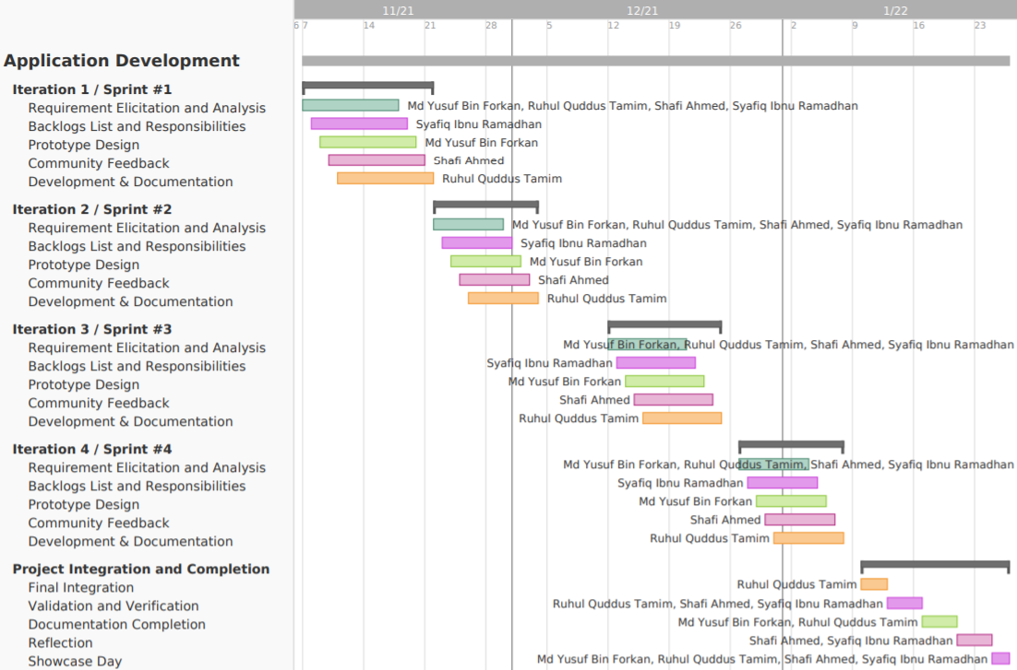
Gantt Chart

Slide 39
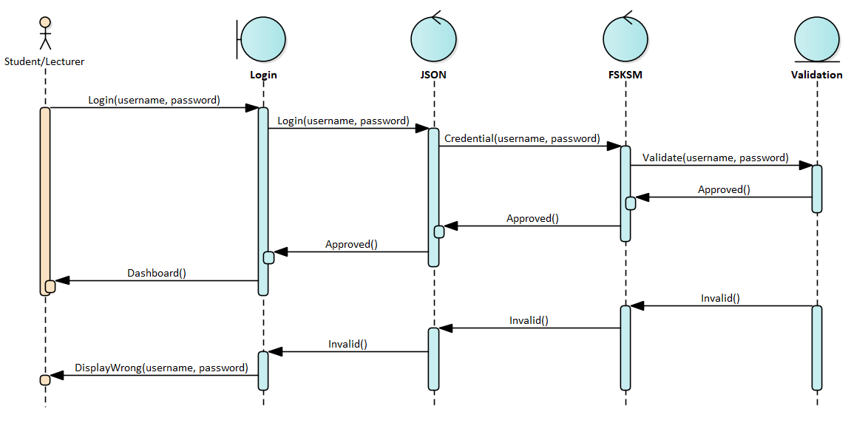
Sequence Diagram UC001

Slide 40
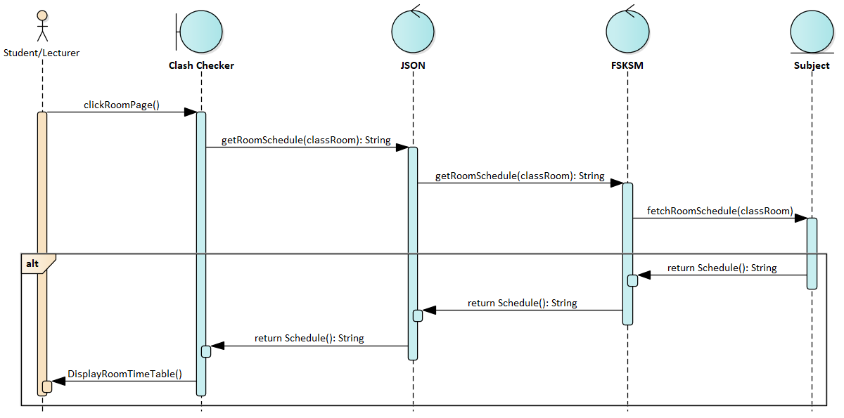
Sequence Diagram UC002

Slide 41
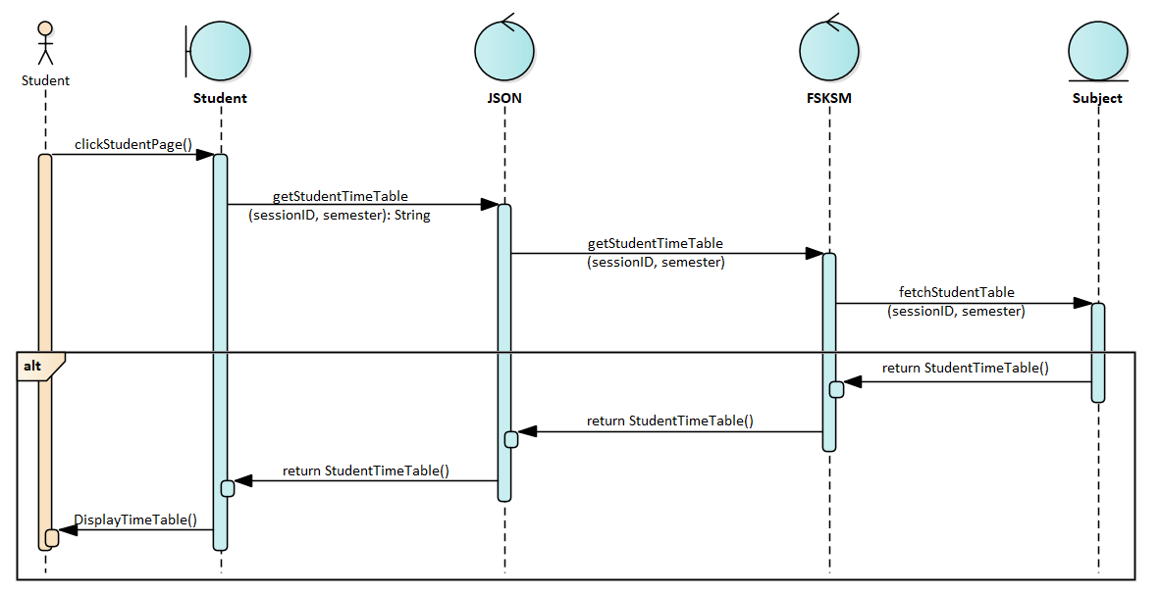
Sequence Diagram UC003

Slide 42
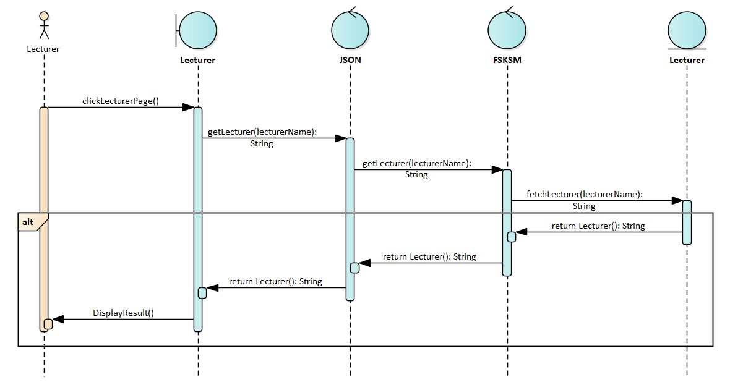
Sequence Diagram UC004

Slide 43
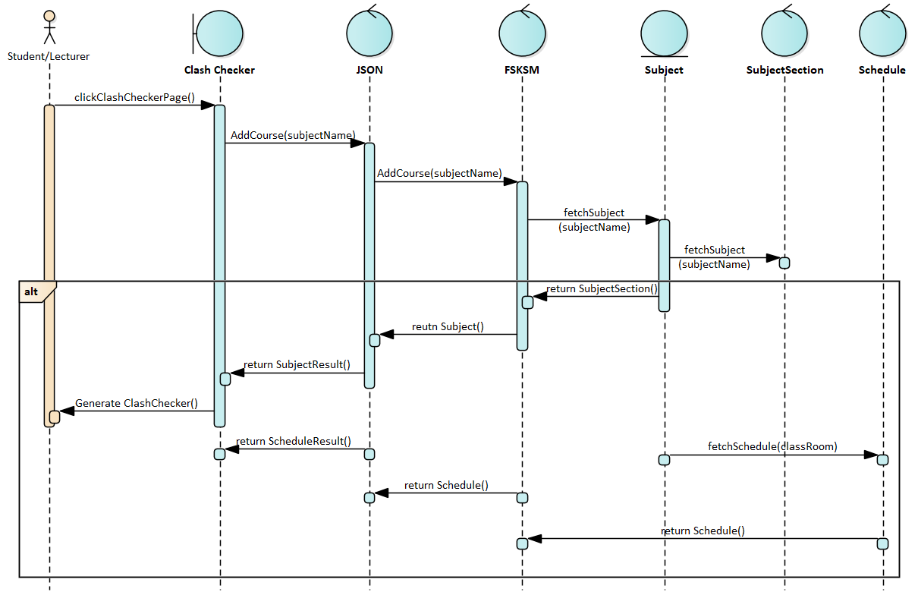
Sequence Diagram UC005

